Slide 1
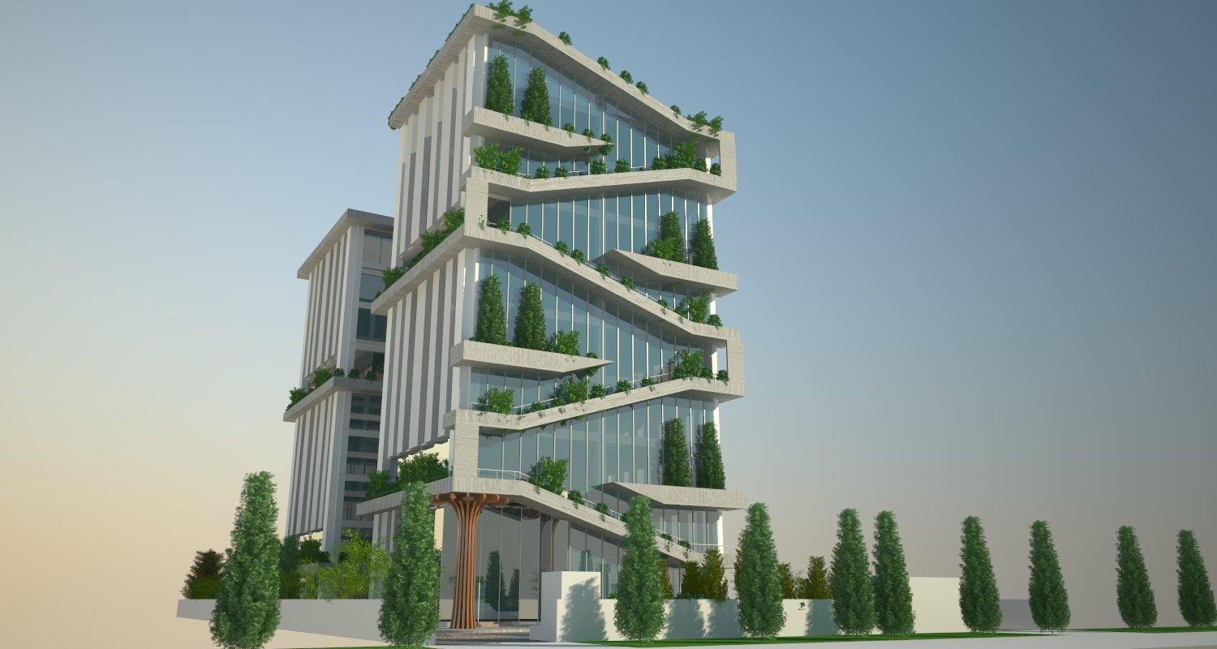
Knowledge Centre Noida

Slide 2
About Knowledge Centre Noida Project
New Modern Buildwell Pvt Ltd (NMBPL) is one of the leading organization in the field of development and construction of Real Estate Projects. The Company is focussed on developing Residential, Commercial and mixed development properties which have tech driven modern facilities , facilitate quality living conditions and are, environmental friendly.
NMBPL owns a land parcel admeasuring 3000 sqm at Plot no. 12, Sector-126, NOIDA (Opposite to Gate no. 2 Amity University) and developing Office complex, ‘Knowledge Centre’ at Noida.
The Office complex is Ground + 5 storey building. Each floor plate of approx. 10,000 sft.

Slide 3
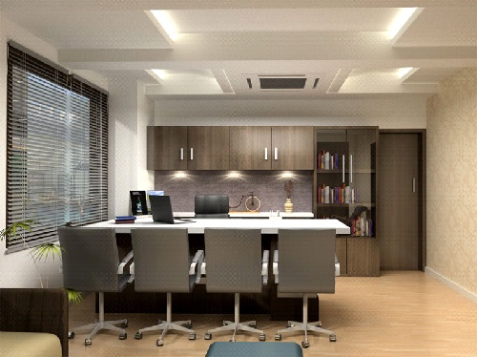
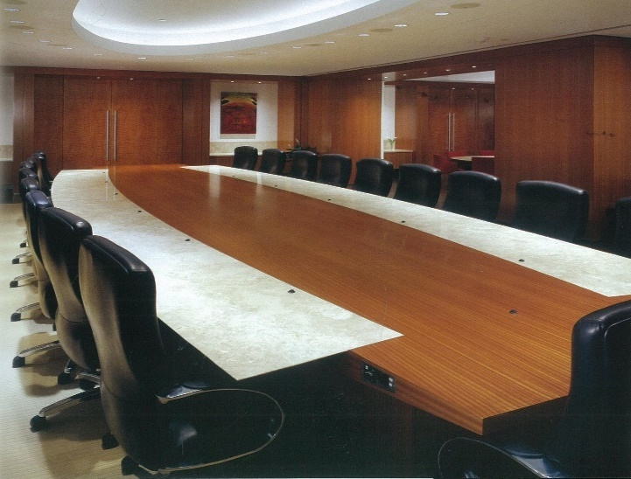
Ideal for multi- user Office
The Complex is well connected with important hubs of Noida and South Delhi like Botanical Garden and Okhla.
Prime road presence & visibility
Large plate office with landscaped plaza. Independent offices upto 10,000 sft area
Generous natural light & views from all usable spaces.
Fully automated building which gives hassle free access to its occupants
Ample car parking in two level basement. Space for electric Car charging in basement

Slide 4
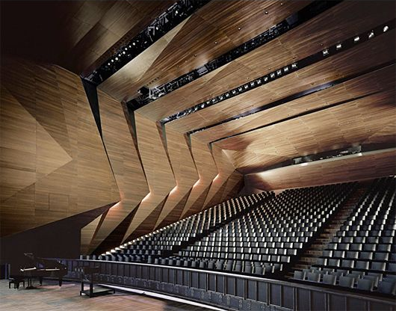
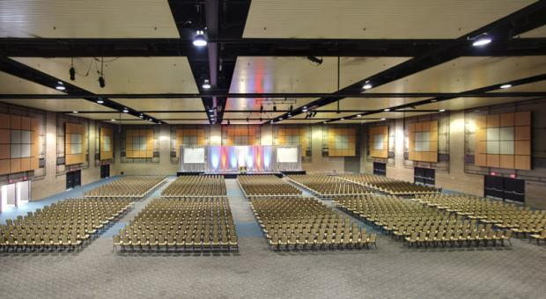
Integrated office space
Integrated Office Space Co-Working Office Spaces
Ground floor for Sports Lounge
Terrace Garden

Slide 5
Sustainable development
Sustainable development having Zero Discharge. Sewage treatment Plant and use of recycled water for arboriculture
Minimizing surface water runoff, Rain water harvesting.
Efficiently using energy, water, and other resources, ensuring minimum wastage.

Slide 6
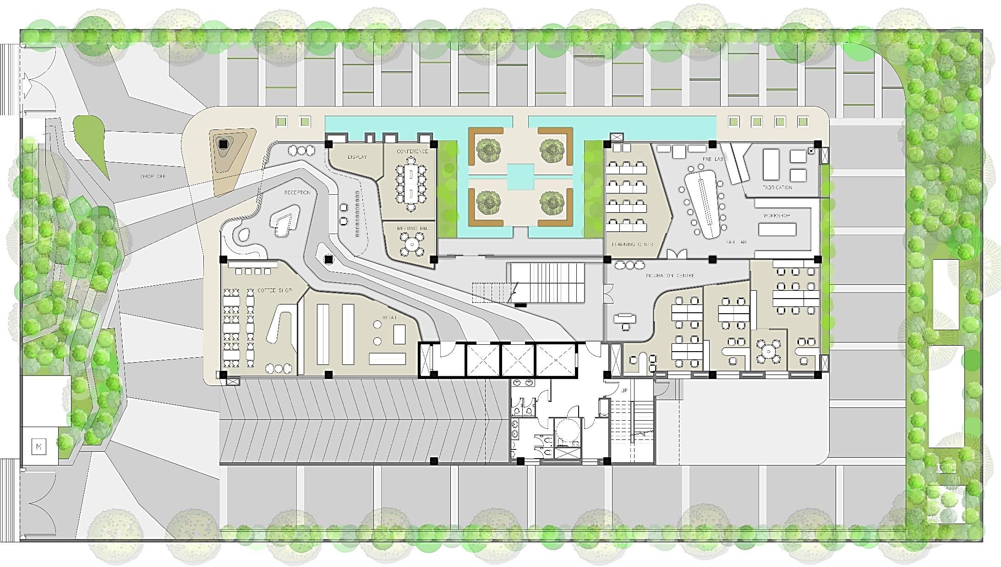
Site Map
ENTRY
5M DRIVEWAY
WATER FEATURE
WATER FEATURE
DIPLAY
MEETING RM.
DROP OFF
RECEPTION
FEATURE WALL.
LANDSCAPE COURT
MEETING RM.
FAB LAB
INCUBATION CENTRE
6M DRIVEWAY
COFFEE SHOP
LANDSCAPE FEATURE
CONVENIENCE STORE
LIFT LOBBY
W
SERVICES
M
H
PARKING
ELEC
, RM
EXIT
5M DRIVEWAY

Slide 7
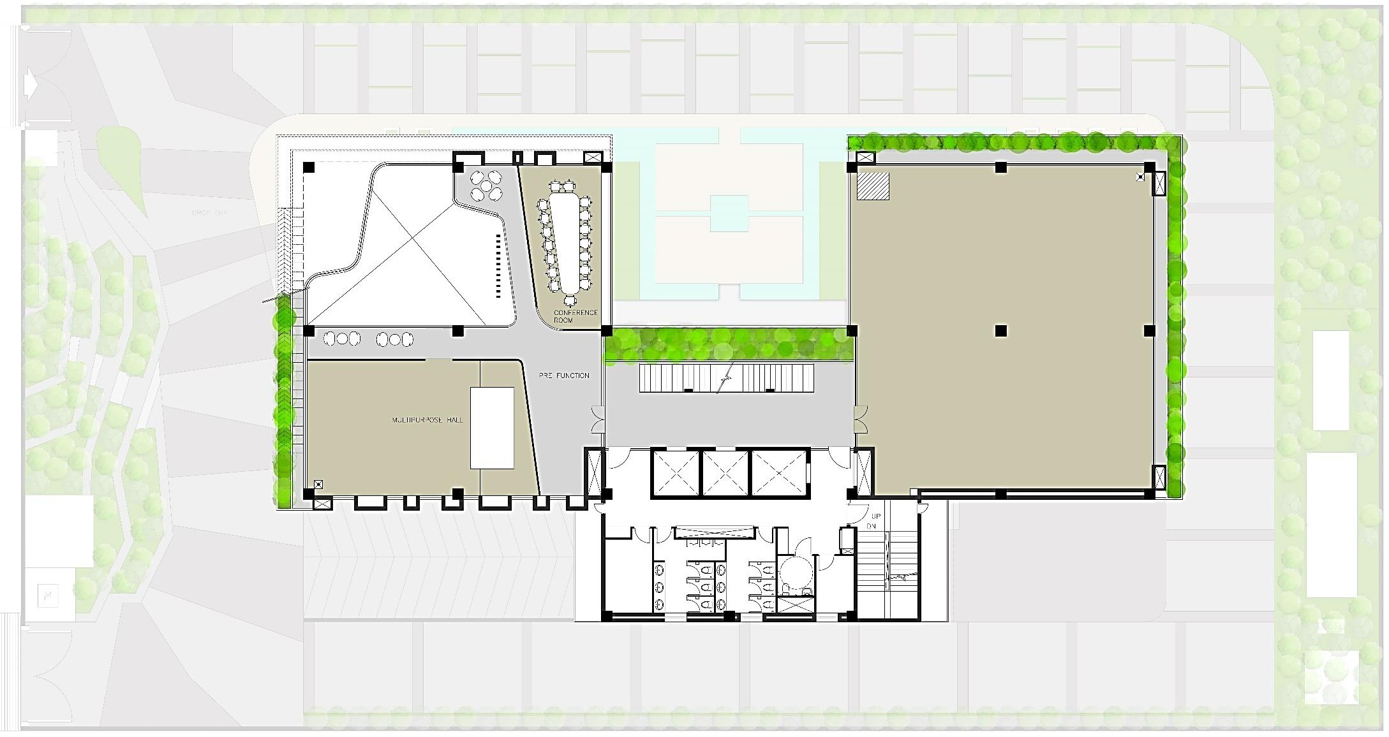
COURT BELOW
RECEPTION BELOW
INCUBATION CENTRE
LIFT LOBBY
First Floor

Slide 8
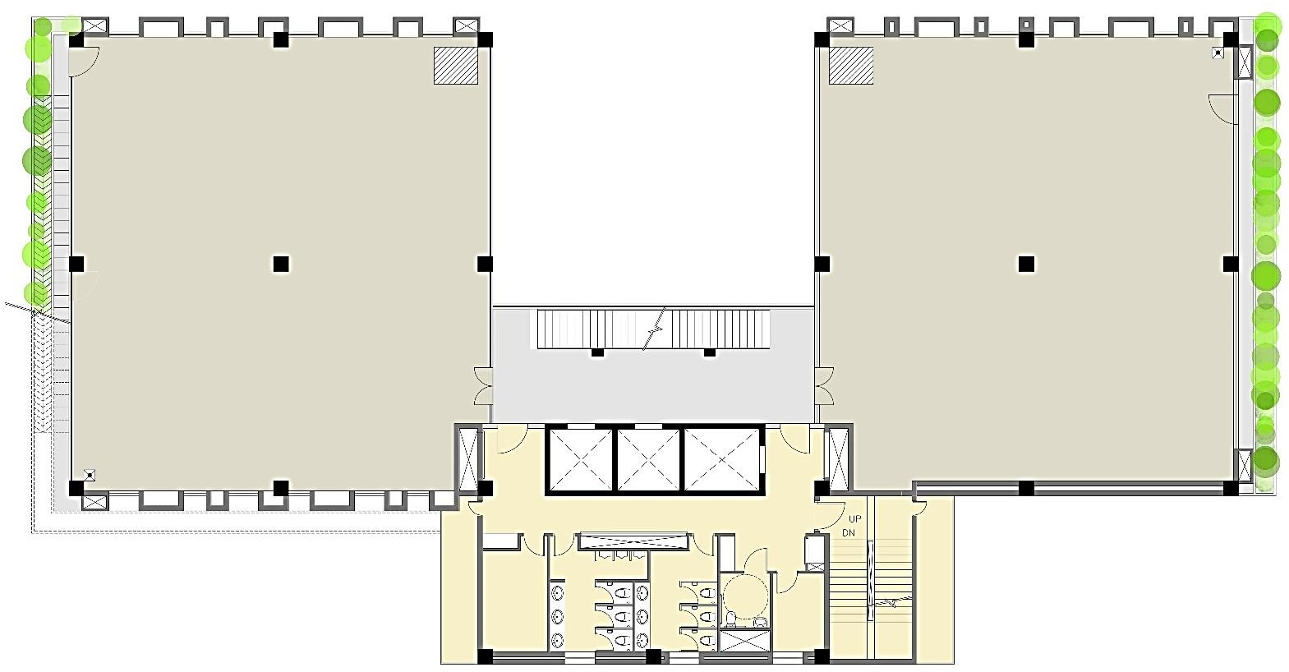
OFFICE SPACE
OFFICE SPACE
LIFT LOBBY
ELEC.
^{RM.}ELEC. ^{M.}
H
W.
ELEC. RM.
RM.
ELEC. RM.
Typical Floor

Slide 9
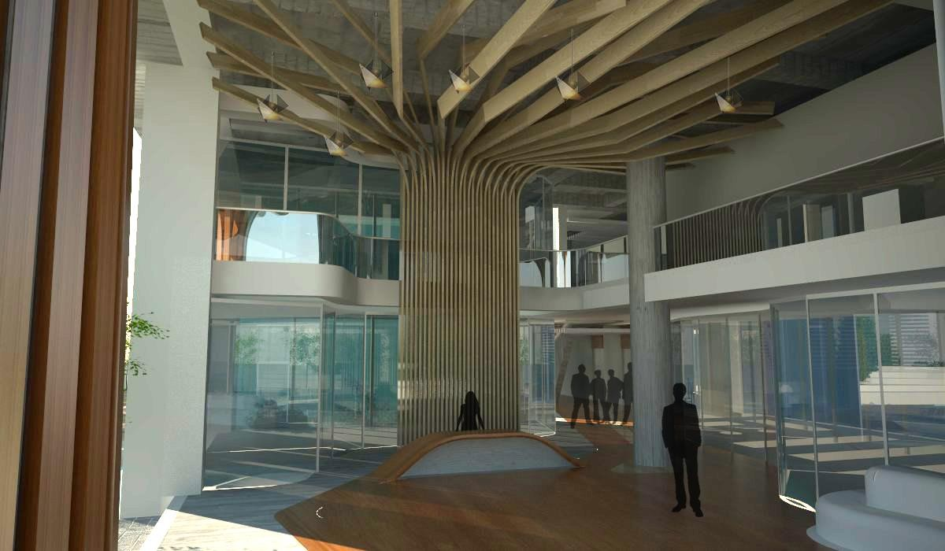
View

Slide 10
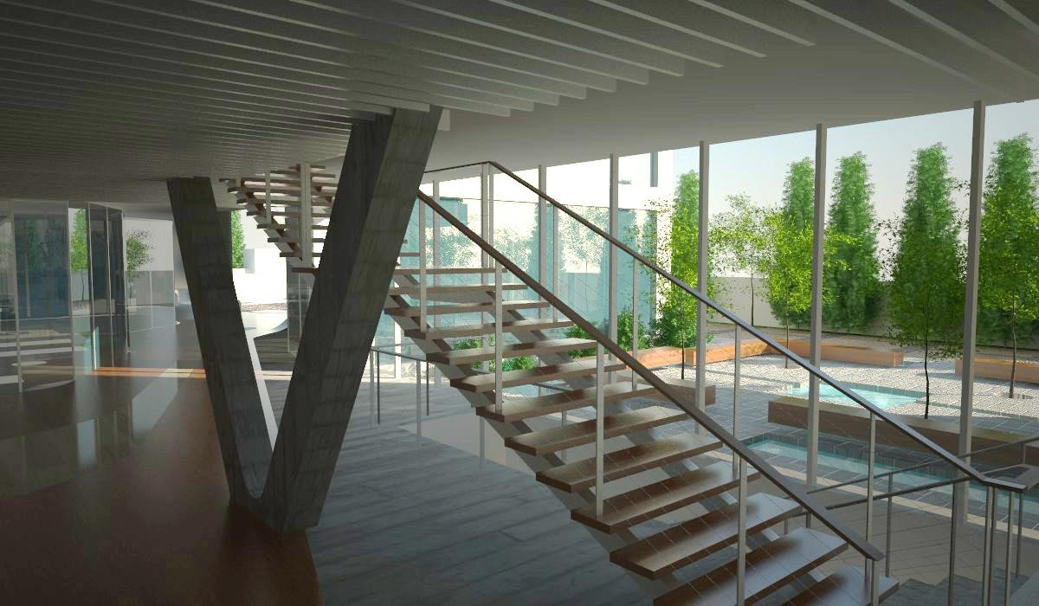
View

Slide 11
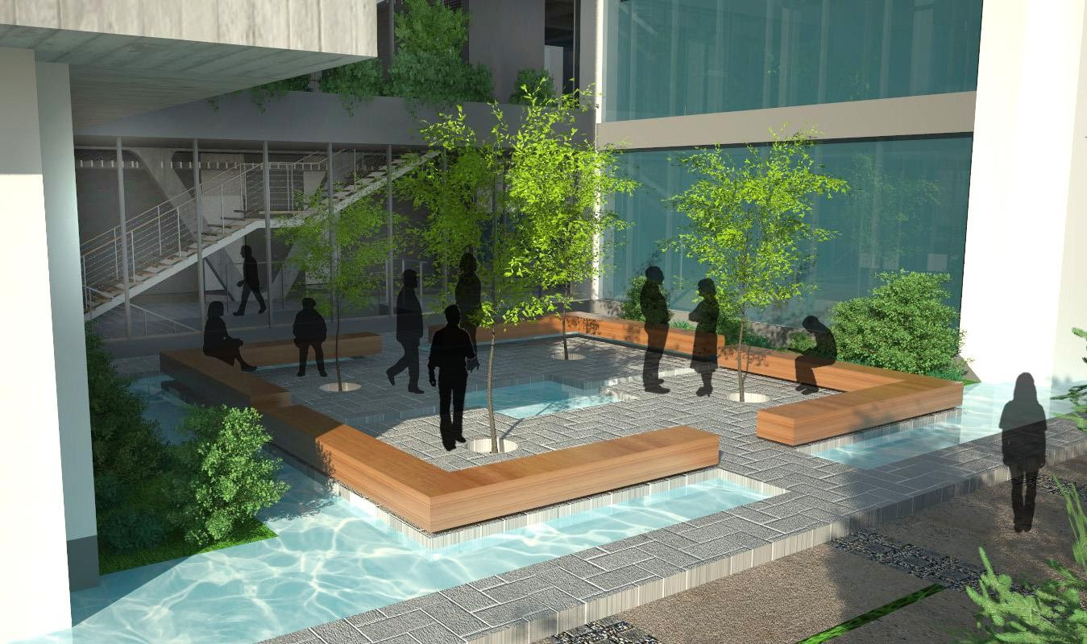
Central Court

Slide 12
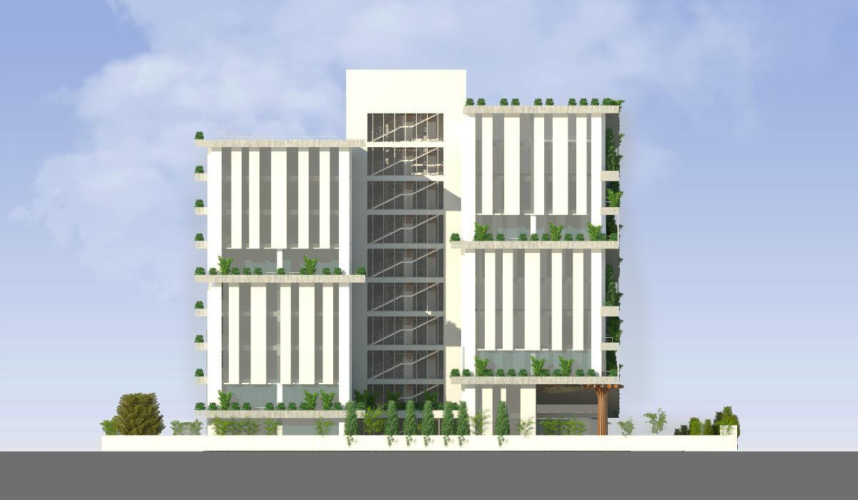
Elevation

Slide 13
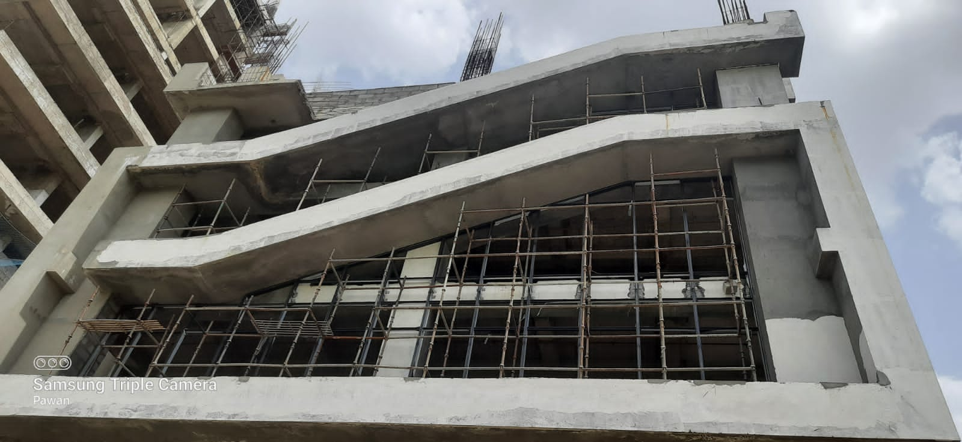
Site Photograph

